Slide 1
Thoracic Cage
Sternum and Ribs

Slide 2
Thoracic Cage
• Bony framework of the chest
• Formed by thoracic vertebrae, ribs, and sternum
• Protects heart, lungs, and major blood vessels
• Supports breathing movement

Slide 3
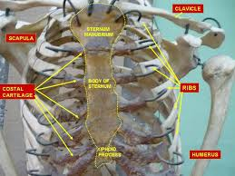
Sternum (Breastbone)
• Long flat bone in the center of the chest
• Consists of:
  - Manubrium
  - Body of sternum
  - Xiphoid process
• Articulates with clavicles and first 7 ribs

Slide 4
PARTS OF STERNUM
  Manubrium
  Manubrium is the broad part and upper part of the sternum. Connects to the clavicles called sternoclavicular joint and with the first two pairs ribs .
  Body of sternum
  It is the longest middle and flat part of the sternum.
  It’s upper and connects to manubrium and its lower end connects to xiphoid process.
  Xiphoid process
  It is present at bottom of the sternum. Give attachment to diaphragm muscles .

Slide 5
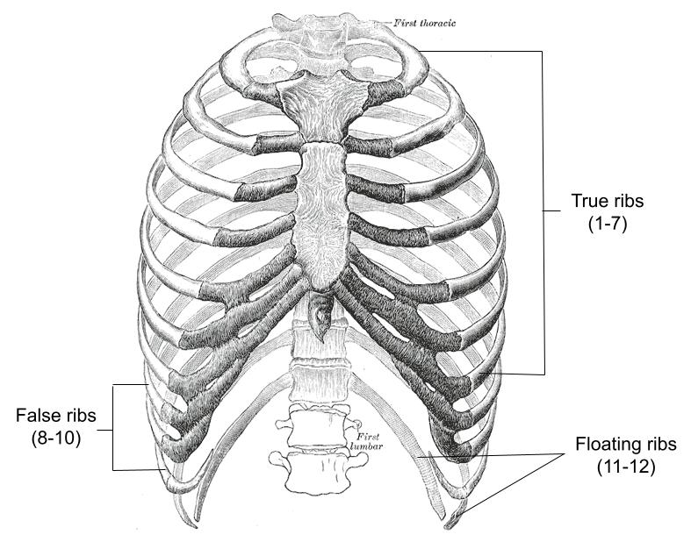
Ribs
• 12 pairs of ribs
• True ribs (1–7): attach directly to sternum
• False ribs (8–10): join cartilage of rib above
• Floating ribs (11–12): no anterior attachment
• Protect thoracic organs and assist in breathing

Slide 6
RIBS
There are 12 ribs present which form lateral walls of the thoracic Cage .
They are elongated and curve bones .
They are anteriorly articulate with sternum and posteriorly with the vertebral column.
Anteriorly the first 7th pairs of ribs articulate directly with the sternum and known as true ribs .

Slide 7
RIBS
8th ,9th,10th pairs indirectly articulate with the sternum.( In both cases costal cartilage articulate with the sternum) Is called floating ribs
11th and 12 th ribs don’t join the sternum anteriorly, their anterior tips being free called floating ribs .

Slide 8
RIBS
Each ribs joints with the vertebral column.
3 joints are there
Two joints are formed between the facets on the head of the rib .
And joined with the facets on the body of two vertebrae. The one above the rib and one below.

Slide 9
RIBS
Out of 12 ribs 10 th ribs means 1st ribs to 10th form joints between the tubercle of the ribs and transverse process of the lower Vertebra.( Example 5th ribs join with the transverse process of 5th vertebra .
11th and 12th ribs don’t have tubercle so they don’t join with the transverse processes of 11th and 12 th transverse process of vertebra .
They joint only with body of 11th and 12th thoracic vertebrae.

Slide 10
RIBS
Each rib has a lower (inferior) surface. On this lower surface there is a deep groove, called the costal groove. This groove acts like a protective channel. Inside this channel run the intercostal nerve, artery, and vein. Between one rib and the rib below it, there are intercostal muscles. These muscles move the ribs up and down during breathing, helping us inhale and exhale

Slide 11
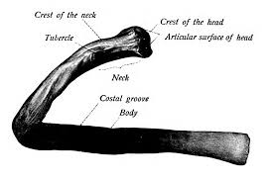
INTERCOSTAL GROOVE IMAGE

Slide 12
RIBS
The ribs are connected to the sternum by costal cartilage
Costal cartilage is a strong but flexible tissue
Because of this cartilage, the rib cage is not rigid
It allows the chest to expand during inspiration and return to normal during expiration
This flexibility is essential for breathing.

Slide 13
Movement of the Ribs cage during breathing ( simple explanation)
The ribs are arranged in a curved way and joined by cartilage, which makes the rib cage flexible Because of this flexibility, the chest can expand and shrink during breathing. The first rib is strongly attached to the sternum (breastbone) in front and the first thoracic vertebra at the back. It does not move when we breathe in or out — it stays fixed in place. When the intercostal muscles (muscles between the ribs) contract, they pull the other ribs upward toward this first rib.

Slide 14
Functions of Thoracic Cage
• Protects heart and lungs
• Supports upper body
• Aids in breathing
• Provides attachment for muscles

